Slide 1
Secure Communications System
Author: Sachin Yadav
Code Link: https://github.com/sachinyadav3496/SuperSecureChatApplication

Slide 2
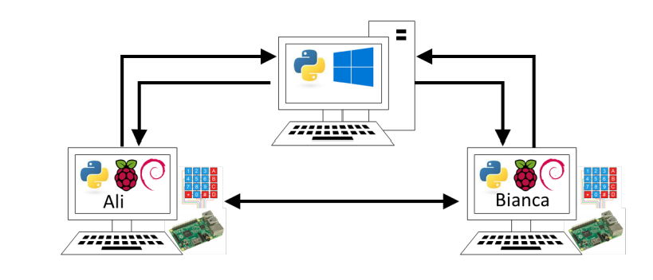
Secure Communications System
Ali and Bianca want to communicate directly
First, They must sign into the system
The Server knows their user ID and password
Once logged in, the server sends them the other’s IP address
They can now communicate directly

Slide 3
System Components
Windows PC
Server Application
Database of User IDs and hashed passwords
Database of logged-in users and their IP addresses
Raspberry Pi (x2)
Chat application
4x4 keypad (for password)

Slide 4

Technology Used
Python Programming
OOPs
State Machines
Socket Programming
Custom Communication Protocols (JSON)
Multi-Processing / Threading
Database
Cryptography

Slide 5
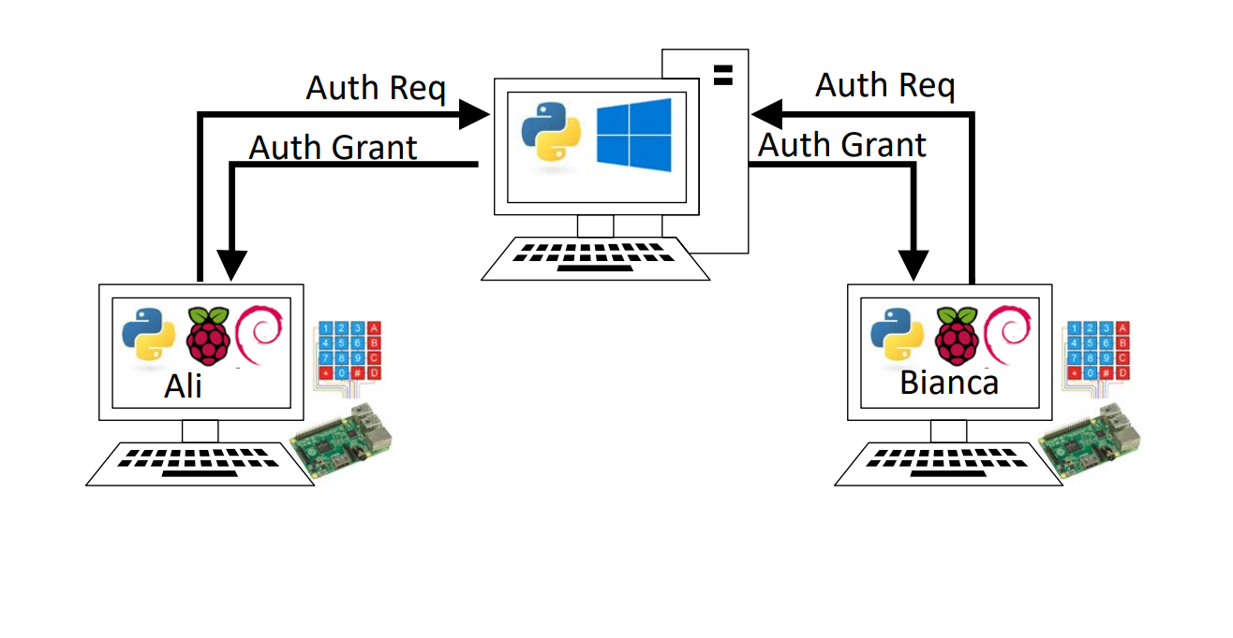
Auth phase: Ali and Bianca each sign in

Slide 6
Authentication Phase
1. User enters user ID on Pi keyboard
2. User enters passcode on 4×4 keypad
3. Application hashes the passcode
4. Application encrypts user ID and passcode
5. Application sends authentication request with user ID & passcode to server
6. Server decrypts the user ID and passcode hash
7. Server compares hashed passcode with stored hash passcode
8. If they match
Server sends authentication grant message
Server stores user ID and user’s IP address
9. Else, server sends authentication denied message

Slide 7
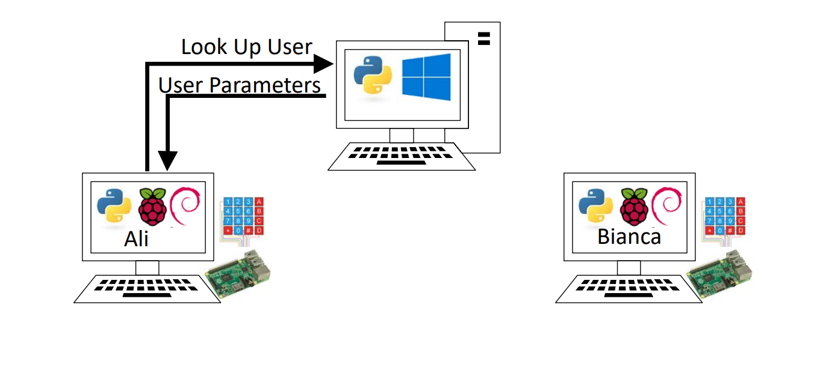
Lookup Phase: Ali -> Bianca
1. Ali chooses “begin chat” and enters Bianca’s ID on keyboard
2. Application sends lookup request with Bianca’s user ID to server
3. Server looks up IP address for that user
4. If user is found,
Server sends user IP address and encryption key
5. Else, server sends Not-Found message

Slide 8
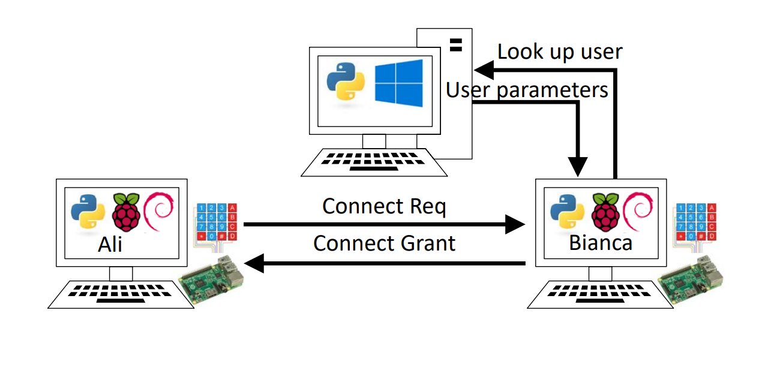
Connect phase: Ali -> Bianca
1. Ali’s application sends connect request to the application at Bianca’s IP address
2. Bianca’s application sends lookup request with Ali’s user ID to server
3. Server looks up Ali’s user data
4. If user is found (Ali is logged in),
Server sends Ali’s IP address and encryption key
5. Else, server sends Not-Found message
6. Bianca’s application sends connect grant message to Ali’s application

Slide 9
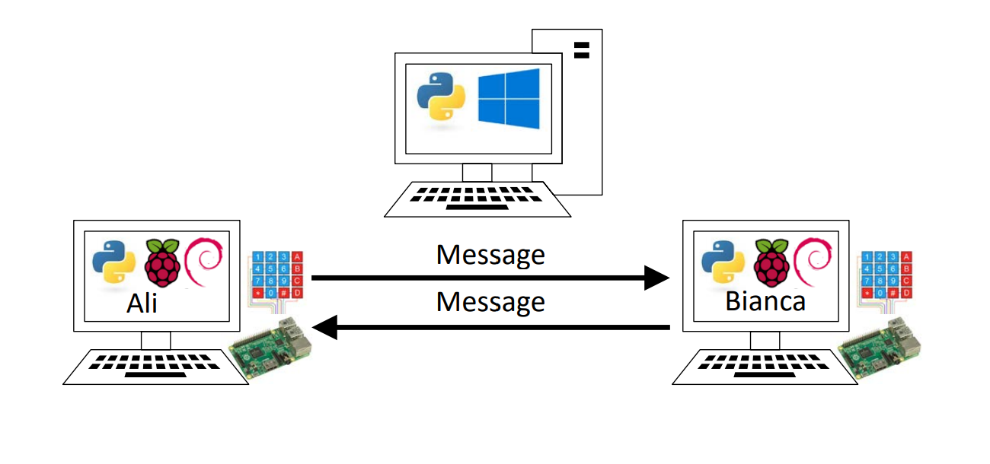
Chat phase: Ali <-> Bianca
1. Ali and Bianca type lines at the Pi keyboard
2. Each application encrypts the line just entered
3. Each application sends the encrypted message to the other application
4. Each application decrypts messages received and displays them to the screen

Slide 10
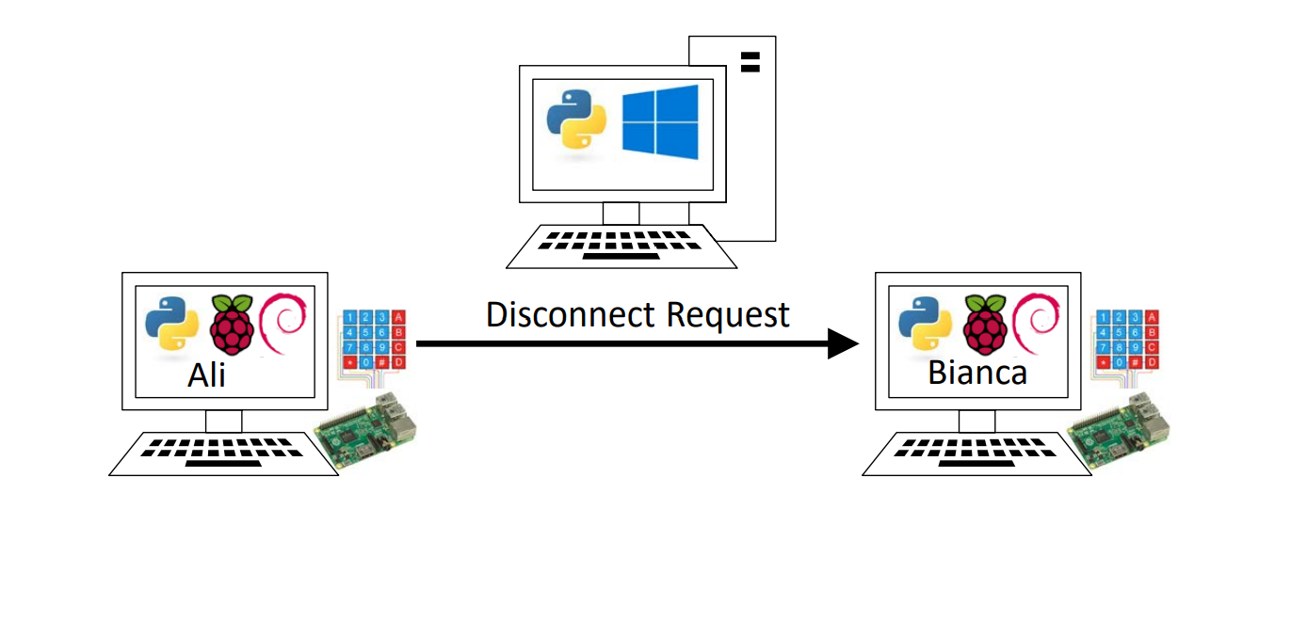
Hangup phase: Ali | Bianca
1. Either Ali or Bianca types a CTRL-C KeyboardInterrupt
2. Application sends a disconnect request to the other application
3. Each application displays “Hang up” to the user
(a disconnect request always results in the end of the chat session)

Slide 11
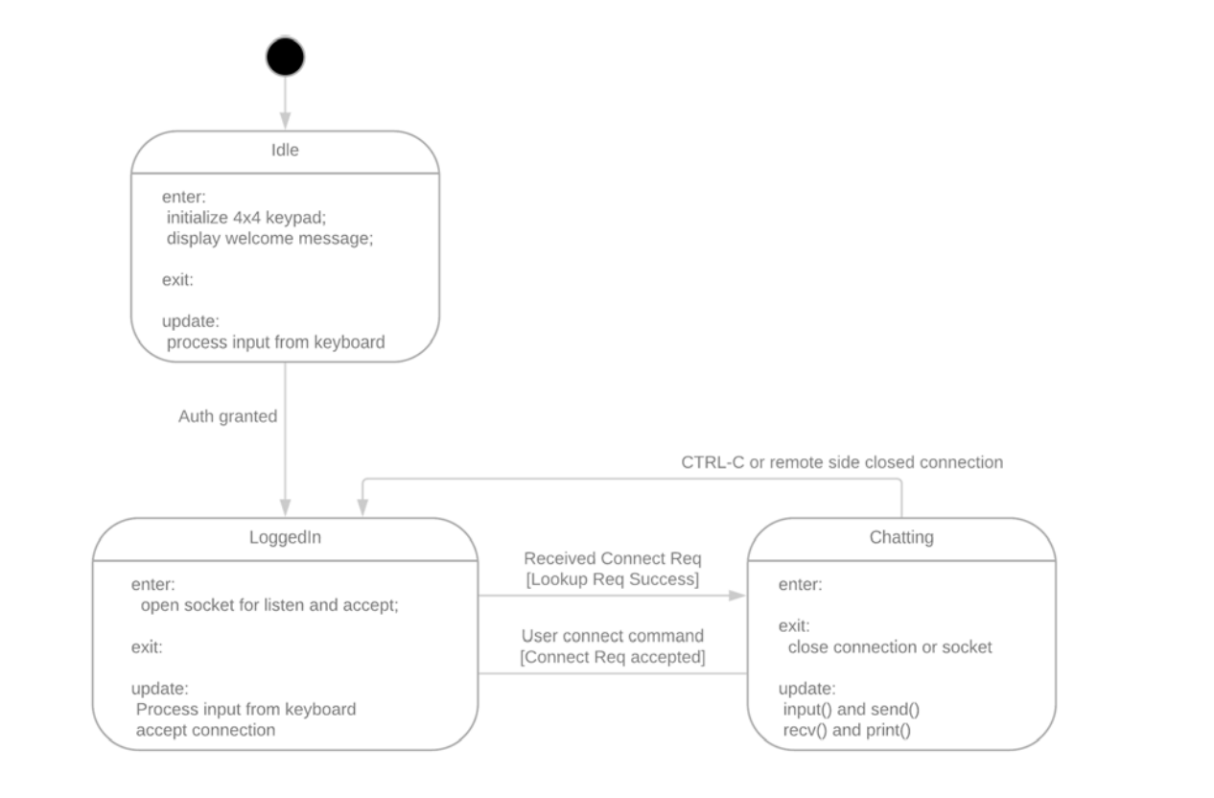
State machines to handle complexity
Client Application is in one of several possible states
Idle – waiting for user to log in
Logged in – waiting for user to request a chat or for connect request
Requesting chat – User made a request, waiting for other side
Chatting – sending and receiving messages

Slide 12

Any Query

Slide 13

Thanks

